Slide 1
Kentucky FAIR Plan Governing Committee Meeting October 23, 2024

Slide 2
Meeting Etiquette & Expectations
Keys to a successful meeting
Please keep your phone on mute to keep background noise to a minimum.
If you need to step away from the phone, please do not place us on hold, as your hold music would disrupt the presenter.
Participation
Role Call: During role call please unmute your phone. We will call you by name and company. We ask that you verbally confirm you are in attendance.
Voting: During voting we ask that you unmute your phone. We will ask for verbal affirmation as we do in our in-person meetings.
Questions: You may ask your question(s) throughout the presentation by unmuting your phone or by typing in the chat box. You may also raise your hand, using the hand icon next to your name in the chat room.
Motions: We ask those who motion and second to identify themselves by name.
Notes:
Mark will lead the group through meeting etiquette and expectations.

Slide 3
Agenda
Roll Call
Anti-Trust Preamble Reminder
Approval of Minutes
Committee Reports
Executive Director’s Report
2025 Budget
Other Business
Adjournment
Notes:
Mark Review agenda & hand it over to Rudy.

Slide 4
Call to Order
Roll Call
Notes:
RUDY
Call the meeting to order-- Welcome to the October 23, 2024, Kentucky FAIR Plan Governing Committee Meeting.
Lead the Roll Call and request Governing Committee members to unmute if they are joining remotely.
Rudy Schlich – Old Kentucky Insurance
Todd Feltman– State Farm
Kristen Mellinger – Kentucky Farm Bureau
Lisa Pierce – Allstate
Jay Kepperling – Nationwide Insurance
Dawn Whalen – Travelers
David Combs – Kentucky National Insurance
Kentucky FAIR Plan Staff:
Mark Hillis
Melissa Chlon
Erin Lux
Tina Faleide
Kentucky Department of Insurance:
Deputy Commissioner, Shawn Boggs
Note that a quorum was present either in person or by proxy.

Slide 5
Approval of Minutes
Anti-Trust Preamble p.4
Prior Meeting Minutes p.5
Governing Committee Meeting
Equity & Reinsurance Committee
Finance & Investment Committee
Claims Committee
Underwriting Committee
Notes:
RUDY
Remind the Committee that they are bound by the Anti-Trust Preamble that is in the meeting packet.
The next item on the agenda is the Approval of the Minutes. The prior meeting minutes are noted on the PowerPoint have been emailed to each of you in advance of the meeting and are included in your meeting documents.
We will need a motion to approve the minutes since the last Governing Committee Meeting.
Ask for a second to the motion.
All in favor say ‘aye’. All opposed say ‘no’. Any abstain? The motion carries.
(Motion: _____________Second:_____________)

Slide 6
Committee Reports
Notes:
Rudy hand it over to Erin

Slide 7
Claims Audit
Kentucky Claims Committee: Stacie Darnell - Kentucky National
Henry Goins - Kentucky Farm Bureau Dan Pendleton - Kentucky Farm Bureau Andy Lewis - State Farm
Wesley Savage – State Farm Claims Committee Meetings:
August 6 & 15, 2024
Notes:
ERIN
We are fortunate to have talented industry professionals on our Claims and Underwriting Committees that donate their time to conduct audits on our FAIR Plan. These folks are committed to excellence, and we appreciate their dedication to the Kentucky FAIR Plan and the insurance industry.
On August 6th, the claims committee met to kick-off the annual audit, then met again on August 15 to wrap up the virtual audit. Similar to last year, this year was a combined audit Committee Meeting with the Illinois FAIR Plan Claims Committee – they audited IL & WI claim files. The IL/WI audit also went very well.
The Kentucky committee audited 70 claim files for losses reported in late 2023 and early 2024. The overall adequacy for these 70 files was 98.4% down slightly from 99.26%, in 2023. General feedback included timely handling, well documented files, attention to detail and a strong partnership between claims and underwriting.
Special THANKS to State Farm for allowing Andy Lewis many years of service on the claims committee and his replacement, Wesley Savage, who joined the team this year as Andy is stepping away.
The Claims Audit Executive Summary is available in your packet starting on page 22.

Slide 8
Underwriting Audit
Kentucky Underwriting Committee:
Andy Heim - Kentucky Farm Bureau Dwayne Taylor - State Farm
Anne Smits – Nationwide Insurance
Underwriting Committee Meetings:
August 20 & 29, 2024
Notes:
ERIN
On August 20th, the Underwriting Committee met virtually to kick-off the annual audit then met again to wrap-up the audit on August 29, 2024.
Within our Articles, we outline the fact that we are to be mindful that the Plan is a residual market mechanism for the placement of distressed business and as such is intended to serve a social need rather than provide a proprietary profit.
A total of 55 underwriting files were audited with an adequacy rating of 100%, up slightly from 2023 at 98.64% (2022 results were 99.21%.) There were no deficiencies found and files were noted as well-documented and within the authority of the Plas as outlined in Article 6.
Thank you to Nationwide for filling a vacancy on our UW committee and for the continued support of State Farm & Farm Bureau.
The full report is available within your packet, page 25.

Slide 9
Reinsurance and Equity Committee Meeting September 17, 2024
Investment Committee Members
Kristen Mellinger – Kentucky Farm Bureau
Todd Feltman – State Farm
Mark Hillis - Kentucky FAIR Plan
Notes:
Mark
During our September 17th meeting, this committee reviewed the Governing Committee Policy, Members’ Equity and Distributions to Members document and agreed to continue the Committee’s position as stated.
The committee also discussed and approved reinsurance renewal:
$5m XS of $1.5m
ROL from a blended 4.68% to a new blended rate of 4.65%
We have seen the market continue to harden.
We have agreement from Odyssey to increase their line to 30% at their non-concurrent ROL of 5% (Deposit pricing of $250,000 on a 100% basis). This creates an avenue to completing the placement at 100% at the lowest common denominator of price (Blended 4.65% ROL or $232,500 total deposit).
The committee also discussed the StoRMi index noting that the Plan does not have any risks in the extreme category, and relatively few in the very high category.
The minutes are located on p.11 of your documents.

Slide 10
Investment Committee Meeting October 16, 2024
Investment Committee Members
Rudy Schlich - Old Kentucky Insurance
Lisa Pierce - Allstate Insurance
Don McConnell– Kentucky Farm Bureau
Chuck McCurdy – Cerity Partners
Ryan Burch – Cerity Partners
Mark Hillis - Kentucky FAIR Plan
Tina Faleide – Kentucky FAIR Plan
Notes:
Tina
The Meeting of the Investment Committee was held October 16, 2024. The Minutes of the Investment Committee Meeting start on page 14 in your documents.
Discussed:
Bank balance in Republic Bank + ICS account reflect a total of $615,098 as of 6/30/24.
Current market trends including increasing rates and the start of market hardening in our state.
Report of Investment Custodian was provided by Chuck McCurdy / Ryan Burch
Investment Analysis was provided by Don McConnell
The committee also discussed the funding of the FAIR Plan Alliance that will be voted on shortly.

Slide 11
Executive Directors Report

Slide 12
Notes:
ERIN
This slide represents new business applications received annually from 2019 through current. The last bar represents our 2024 year end projection. Following a downward trend for several years, we have been slowly trending up since 2022 which accurately reflects the market and the challenges some are facing finding cover in the standard market.

Slide 13
Notes:
ERIN
Written premium was $1,735,562 through August. The projection for 2024 is just over $2.6M in written premium, an increase of 5.2%.

Slide 14
Notes:
ERIN
Our loss ratio decreased when compared to last year. Our LAE ratio increased nominally. Both have remained stable over the past couple of years. We will show a breakdown of claims momentarily.
Combined ratio:
124% Q2 2024
165% Q2 2023
119% Q2 2022

Slide 15
Notes:
ERIN
The operating expense ratio has remained stable year over year with a slight increase in 2024.

Slide 16
Notes:
ERIN
Through August, KY has had 89 reported losses, and we anticipate ending the year with around 134 claims. This is thankfully, dramatically lower than last year (with the March 2023 wind event.)
Our largest driver continues to be wind and hail losses.
CAT Information:
CAT 2319 (February 2023) – 2 claims; $17,703
CAT 2325 (March 2023) – 127 claims; $659,315
CAT 2333 (March/April 2023) – 17 claims; $97069
CAT 2352 (June/July 2023) – 9 claims; 24,580
TOTAL: $798,667

Slide 17
Banking and Investments
Republic Bank Operating Account
Cash Flow Balance: $777,053
ICS: $2,829
Members Equity Account (Disbursement): $227,741
$226,205 will be escheated on 11/1.
Cerity/Fifth Third Investment Account
$14,258,073
Notes:
Mark
Above is a snapshot of our bank balances as on 9/30/2023.
Republic Bank balance: $777k (Cash Flow + ICS)
Members Equity account currently has $227k but the escheat process happens on November 1st. That will leave $1,536 in that account.
The investment account has just under $14.5 million.

Slide 18
Budget
Details in your packet, page 32.
2024: Projected to come in under budget.
2025: Proposed budget of $1,872,805
Notes:
Mark
We are trending to end 2024 under budget. For 2025, as with every year, we start with zero-based budgeting and put time and effort into each line item, making sure we are as efficient as possible
We have not received health insurance rates for 2025, but we are expecting an increase. We continue to shop the market year after year looking for cost effective plans for our employees.
We do not have a pensions plan, but rather a defined contribution plan.
The 2025 budget is in your documents on page 32. You will notice a line for the Alliance, which is a direct offset of services offered and billed. This may be the last time we will see this line items since wages, benefits, etc. are being incorporated into the Alliance LLC.

Slide 19
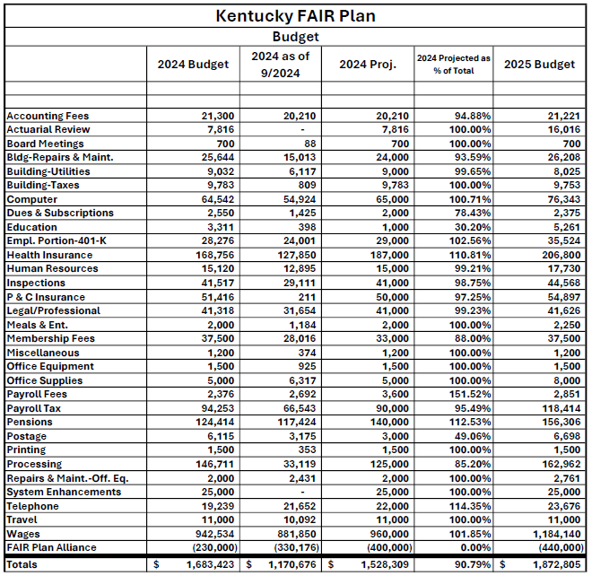
Notes:
Mark
We will need a motion to approve the 2025 budget of $1,872,805 which includes an anticipated offset of $440k.
Ask for a second to the motion.
All in favor say ‘aye’. All opposed say ‘no’. Any abstain?
The motion carries.
(Motion: _____________Second:_____________)
Historical Proposed Budgets:
2016: $1,905,113
2017: $1,777,807
2018: $1,692,925
2019: $1,667,006
2020: $1,627,765
2021: $1,623,408
2022: $1,629,245
2023: $1,800,542
2024: $1,683,423

Slide 20
FAIR Plan Alliance Members
Illinois
Indiana
Minnesota
Wisconsin
Missouri
Washington
Kansas
Oregon
Colorado
Notes:
MARK
Provide an update on the Alliance.

Slide 21
Other Business
Committee Assignment Update – Page 33
Kentucky Department of Insurance Comments
Next meeting dates: June 4 & October 22
Notes:
RUDY
Updated committee assignments are included in your meeting packet on PAGE 33.
Open the floor to Deputy Commissioner Boggs for comments.
Next meetings will be Wednesday June 4, 2025 and October 22nd 2025
Does anyone have any other business to discuss?
We will need a motion to adjourn the fall 2024 Governing Committee Meeting.
Ask for a second to the motion.
All in favor say ‘aye’. All opposed say ‘no’. Any abstain?
The motion carries.
(Motion: _____________Second:_____________)

Slide 22
Adjournment

