Slide 1
Kentucky Auto Insurance Plan
Annual Meeting June 18, 2025

Slide 2

Meeting Etiquette and Expectations
Keys to a successful meeting
Please keep your phone on mute to keep background noise to a minimum.
Please do not place us on hold, as your hold music may disrupt the meeting.
Participation
During roll call please unmute your phone. We will call you by name and company. We ask that you verbally confirm you are in attendance.
During voting we ask that you unmute your phone. We will ask for verbal affirmation as we do in our in-person meetings.
Feel free to ask questions at any point during the meeting.
We ask those who motion and second to identify themselves by name.
Notes:
Mark
Welcome to the KAIP Governing Committee meeting.
A few things before George kicks off the meeting for those on the phone.
Please keep your phone on mute to minimize background noise.
Please unmute your phones for Roll Call; to Vote; or to Ask Questions.
When making motions, or seconding motions, please start by stating your name so that we can properly record each motion.

Slide 3
Annual Meeting Agenda
Call to Order
Anti-Trust Preamble
Approval of Minutes
Election of Members of Governing Committee
Other Business
Adjournment
Notes:
GEORGE
Call the Annual Meeting to order – “Welcome to the June 18th, 2025, Kentucky Automobile Insurance Plan Annual Meeting”
If in attendance, please welcome Deputy Commissioner Shawn Boggs from the Kentucky Department of Insurance.
Take a roll call –
GOVERNING COMMITTEE MEMBERS
___George Moore, Kentucky Associated GC Fund
___ Brad Erdman, Kentucky National Insurance
___ Kristen Mellinger, Kentucky Farm Bureau Insurance
___ Christopher Migliozzi (Via Zoom), Nationwide Insurance
___ Rudy Schlich Old Kentucky Insurance Company
PLAN REPRESENTATIVES
___ Mark Hillis, Kentucky Insurance Plans
___ Erin Lux, Kentucky Insurance Plans
___ Tina Faleide, Kentucky Insurance Plans
KENTUCKY DEPARTMENT OF INSURANCE REPRESENTATIVES
___ Shawn Boggs, Kentucky Department of Insurance (if on the line)
GUESTS
___Sarah Antle, DMLO
___ Raquel Vega-Gaskins, State Farm Insurance (Angie Haston, State Farm, replacement)
Bert Hackenberg representing Erie Insurance has appointed me, George Moore, as his proxy.
Seek any other guests on the phone. “If we have any other attendees who have not been named, we ask that you please identify yourself at this time.”
Note that a quorum is present.

Slide 4
ANTI-TRUST PREAMBLE
Full Preamble Included in Meeting Documents
Antitrust laws aim to protect the public from agreements among insurance competitors that affect the price or distribution of products. Also, the laws aim to promote fair and vigorous competition in the insurance marketplace.
The agenda and discussion items for each meeting are limited to matters of the Kentucky Automobile Insurance Plan, and attendees shall not discuss business interests of their individual insurer members. Each Governing Committee Member and/or officer shall not discuss competitive information of any insurer member.
Notes:
GEORGE
Each of you were provided with a copy of the anti-trust preamble on page 2 of your meeting documents. I would just remind everybody that you are bound by this preamble.

Slide 5

APPROVAL OF MINUTES
June 19, 2024
Annual Spring Meeting
Notes:
GEORGE
“Each of you received copies of the minutes of our June 19, 2024, Annual Meeting. These are on page 3 of your documents. At this time, I would like to ask for a motion to approve those minutes.”
__________________________ _____________________________
Motion to Approve. Ask for a second to the motion.
All in favor say “aye”. All opposed say “no”. Any abstain? The motion carries.

Slide 6

Election of Members of Governing Committee
Chartered in Kentucky | Kentucky Farm Bureau | Kristen Mellinger
Chartered Outside of Kentucky | Erie Insurance Co. | Bert Hackenberg
Independent Agent | Old Kentucky Ins. | Rudy Schlich
Chartered in Kentucky | Kentucky National Ins. | Brad Erdman (Vice Chair)
Chartered Outside of Kentucky | Nationwide Mutual Ins. | Christopher Migliozzi
Chartered Outside of Kentucky | State Farm Insurance | Raquel Vega-Gaskins
Chartered in Kentucky | KY Associated GC Fund | George Moore (Chair)
Guest from the Insurance Department | KY Dept. of Insurance | Shawn Boggs
Plan Representative | Kentucky Auto Ins. Plan | Mark Hillis
Notes:
GEORGE
“You will find on this slide a list of the members of the Governing Committee. State Farm has provided a new member: Raquel Vega-Gaskins is replacing Angie Haston following Angie’s retirement. At this time, I would ask for a motion to elect the members and formally seat our Governing Committee.”
___________________ ______________________
Motion to Approve. Ask for a second to the motion.
All in favor say “aye”. All opposed say “no”. Any abstain? The motion carries.

Slide 7
Adjourn Annual Meeting
Notes:
GEORGE
“This concludes our Kentucky Insurance Plans Annual Meeting. Unless there is other business to discuss, I would ask for a motion to adjourn our Annual Meeting and we will then move into our Governing Committee meeting.”
___________________ ______________________
Motion to adjourn. Ask for a second to the motion.
All in favor say “aye”. All opposed say “no”. Any abstain? The motion carries and our annual meeting is adjourned. We will now move into our Governing Committee meeting.

Slide 8
Kentucky Auto Insurance Plan
Governing Committee Meeting
June 18, 2025

Slide 9

Governing Committee Meeting Agenda
Roll Call
Anti-Trust Preamble
Approval of Minutes
Election of Officers
Independent Auditor Reports
CAIP Financial Statement
CAIP Servicing Carrier Allowance
Secretary Treasurer’s Report
Rate, Rule and Form Changes
Other Business
Adjournment
Notes:
GEORGE
I would like to call the Kentucky Automobile Insurance Plan Governing Committee Meeting to order. Indicate that a Quorum was established in the annual meeting prior to this meeting.
Remind everyone that all remain bound by the Antitrust Preamble.

Slide 10
APPROVAL OF MINUTES
October 31, 2024
Executive Committee Meeting
Notes:
GEORGE
The next item on the agenda is the Approval of Minutes and Ratification of voting actions. The Executive Committee Meeting minutes are included on page 9 of the meeting documents.
I would like to ask for a motion to approve the minutes of the executive committees since our last Governing Committee meeting and to ratify the actions of our committee.
___________________ ______________________
Motion to Approve. Ask for a second to the motion.
All in favor say “aye”. All opposed say “no”. Any abstain? The motion carries.

Slide 11
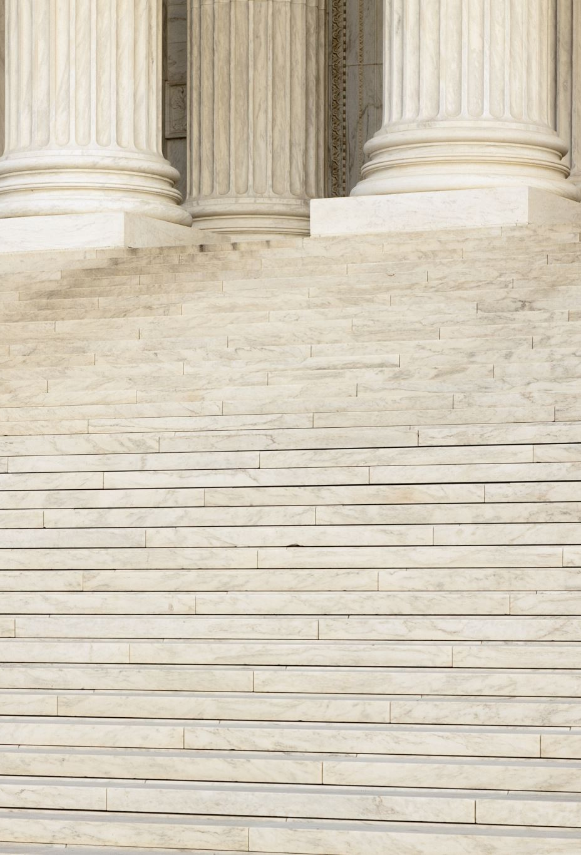
Election of Officers
  Chair: George Moore
  Vice Chair: Brad Erdman
  Secretary-Treasurer: Mark Hillis
Notes:
GEORGE
I’d like to turn the meeting over to Kristen Mellinger who will address the Election of Officers.
KRISTEN MELLINGER
We would like to nominate and motion for: George Moore as CHAIR – Brad Erdman as VICE CHAIR - Mark Hillis as Secretary Treasurer.
Are there any other motions from the floor? With none heard, please close the nominations. I’d like a motion to approve these nominations.
___________________ ______________________
Motion to Approve. Ask for a second to the motion.
All in favor say “aye”. All opposed say “no”. Any abstain? The motion carries.

Slide 12

Independent Auditors Reports
2024 KAIP/PAIP Auditor’s Report – Starting on Page 15
  Sarah Antle - Deming, Malone, Livesay & Ostroff
2024 KY CAIP Statutory Financial Statement / Audit – Starting on page 33
  KPMG
Notes:
MARK
DMLO and Sarah Antle continue to provide auditing for the Kentucky Plans and the FAIR Plan Alliance. They have also expanded their residual market work to include Kansas, Illinois and a few other states saving the industry tens of thousands of dollars annually. Thank you, Sarah.
Mark will turn the meeting over to Sarah for her review. Once Sarah is done, Mark will make note of the CAIP audit by KPMG.

Slide 13
2026 Servicing Provider Allowance
Page 54-56
Administrative Expense Allowance
  2019: 18.4%
  2020: 18.8%
  2021: 18.3%
  2022: 18.1%
  2023: 18.0%
  2024: 17.9%
  2025: 17.5%
  2026: 17.3%
Loss Adjustment Expense
  ALAE: direct reimbursement
  ULAE:
    2019: 13.4%
    2020: 8.9%
    2021: 7.0%
    2022: 8.2%
    2023: 9.1%
    2024: 12.0%
    2025: 3.9%
    2026: 3.8%
Notes:
MARK
As each of you know, when the industry was asked just a few years ago for carriers willing to service the commercial business, there was but one insurer willing to continue to do so. For 2026, you will see that Administrative Expenses will move from 17.5% down to 17.3% And ULAE will move from 3.9% to 3.8%. You will recall, that in September of 2022, we began writing commercial using a fronting company (National Specialty and using AIPSO as the service provider.)
At this time, I would ask for a motion to approve the administrative expense allowance and loss adjustment expense for servicing commercial auto for 2025.
___________________ ______________________
Motion to Approve. Ask for a second to the motion.
All in favor say “aye”. All opposed say “no”. Any abstain? The motion carries.

Slide 14
SECRETARY TREASURER’S REPORT
2024 Budget $205.325
Actual $197,160
2025 Budget $212,216
Benefits, Wages and Travel (CAIP)
Retirement transition
Efficiencies in all areas
FAIR Plan Cost Sharing Alliance
Notes:
MARK
We will now move through some results of our operation. (Budget is on page 57 of meeting documents.)
For 2025 our executive committee approved and administrative budget of $212,216. However, because we had extra funds remaining from prior years, the recommended and approved assessment was just $168,285 which was $30k less than 2023. There was simply the $100 annual fee charged for 2025 AIPSO operations per carrier.
We continue to see pressure annually in all of our organizations for health insurance. However, we also continue to focus upon operational efficiencies. In that regard, you will recall that we transitioned the daily operations of the Plan to AIPSO effective April 1, 2018. This aligns us with the majority of the states across the country and will provide costs savings for many years. We began to see returns on this in 2019 and continue to see these today as we transition staffing here locally through retirements which take place late this year and early next year.
We also have worked hard over the last few years to make sure that each of our employees are cross trained, so that we can efficiently share resources and allocate each employee based upon the needs of a Plan. This allows for us to continue to focus on saving the industry money. This cross training now includes training to assist Plans in other states.
Plans have continued to assist other states though the FAIR Plan Alliance and we bill other states for our services. This offsets some of our wages and benefits costs, reducing our overall expenses in Kentucky – and at the same time, provides for savings and efficiencies in other states as well.

Slide 15

Commercial Auto Underwriting
22 policies in force
$631,600 Written Premium
Notes:
ERIN
AIPSO handles our commercial auto plan under the company National Specialty, with a team led by Matt Mayfield who has been involved in residual auto markets for many years (with Progressive & National Continental previously.)
National Specialty wrapped up 2024 with $631K in written premium and a book of 22 policies made up of 73% Auto Dealers and 27% Business Auto policies. Q1 2025 showed a slight increase with a PIF count at 25 as of end-of-March.
Kentucky Auto Plan policies do not renew beyond the 3rd term. Those who continue to need coverage can of course reapply.

Slide 16
Commercial Auto Claims
Notes:
ERIN
National Specialty ended 2024 with 4 open claims. Loss data , including $54K paid losses noted on the slide.
As of Q1 2025 there are also 4 open claims with reserves at $267K

Slide 17
Overview of the PAIP Market
Notes:
ERIN
Moving over to our personal auto side, this slide shows policies written since 2017. We ended 2024 with 6 new policies written, down from 14 in 2023. Through Q1, we have written 2 new policies and have 4 policies in force.
Kentucky Auto Plan Staff reviews AIPSO’s handling of incoming applications by checking a sample for timely and effective processing as the app goes through the underwriting process. We also review claims processing, including ongoing claims handling.
As a reminder, in 2017, we had just under 700 applications.
In 2018, we had over 500.
In 2019, the first year of the PAIP, we had just 50.
In 2020, the second year of the PAIP we had just 49
In 2021, the third year of the PAIP we had 18.
In 2022, the fourth year of the PAIP, we had 2.
In 2023 we issued 14 policies.
In 2024 we issued 6 policies.
In 2025, through March, we have issued 2.

Slide 18
Overview of the PAIP Market
Notes:
ERIN
Our Written Premium decreased in 2024 compared to 2023, corresponding to the decrease in policies written. We ended 2024 with just over $33K in written premium, 6 policies issued for the year and 4 policies in force.
Written Premium YOY
$105,197
$110,506
$48,790
$22,076
$93,272
$33,539

Slide 19
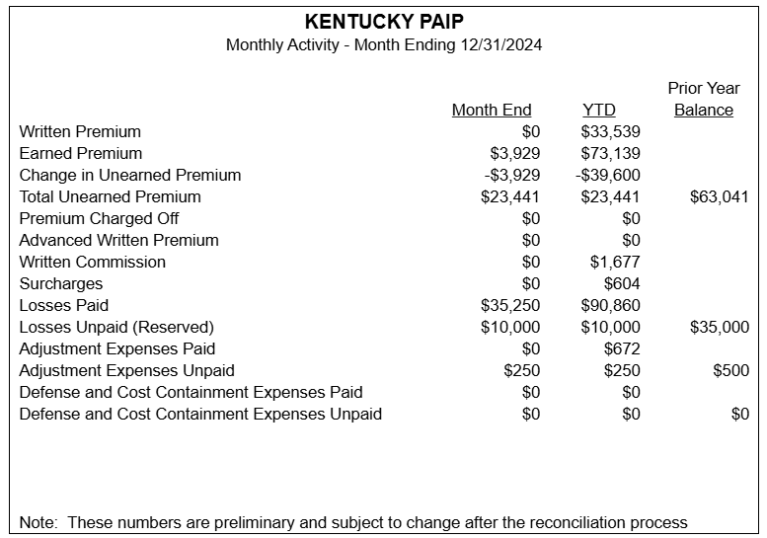
PAIP Results 2024
Notes:
ERIN
This is a snapshot of our personal auto results for 2024. We continue to see a significant decline in applications. This is driven by continued education to producers, as well as the fact that the voluntary market has continued to provide avenues for coverage for this business.
You will see that we had under $35k in written premium.
In 2025, as of month-end for March we have had 2 new policies written in 2025, and a total of 4 policies in force.

Slide 20
Internal Audits
  Personal Auto Applications
  Renewal Processes
  Time Service
  Claims
Notes:
ERIN
Kentucky staff conduct regular audits of Claims Handling and PAIP processing to include application reviews, timeliness, adherence to the Plan Manual and appropriateness of outgoing documents.
The Plan’s staff (Michael for Commercial and Keith for Private Passenger) are making the relationship with AIPSO a priority to continue to drive results and gain focus for our small plan. Keith visited AIPSO headquarters last fall and Michael has held multiple meetings this year with our CAIP partners in Cleveland (AIPSO’s satellite office) and may visit in Q1 2026.

Slide 21
Private Passenger Rate Review
  Prior Filings:
    1/1/16: +11%
    1/1/17: +4.7%
    1/1/18: +6.4%
    1/1/19: +23.0%
    1/1/20: +13.2%
    1/1/21: +9.8%
    1/1/22: +4.7%
    1/1/23: +11.1%
    1/1/24: +10.4%
    1/1/25: +17.7%
2026 Actuarial Proposal, p. 60
Adopt an indication of 12.3%, with an estimated monetary impact of just $6,767 with an allowance of +/- 2.5% for any needed revisions.
Effective January 1, 2026 – new & February 1, 2026 – renewals.
Notes:
MARK
(Starting on page 60 of the documents.) We know that in some instances we are price competitive. Each year we conduct a rate review. For 2026 the actuarial review reflects the need to take a 12.3% uncapped increase for Personal Auto. Because we know we are rate competitive and should not be, and because the monetary impact is small (under $7K), I recommend that we stay in line with the rate indications and take this rate increase effective 1/1/2026. This recommendation is consistent with our actions over the past number of years, and consistent with our filings and approvals with the DOI.
___________________ ______________________
Motion to Approve. Ask for a second to the motion.
All in favor say “aye”. All opposed say “no”. Any abstain? The motion carries.

Slide 22
Commercial Auto Rate Review
  Prior Filings:
  1/1/16: -2.2%
  1/1/17: -4.9%
  1/1/18: +5.7%
  1/1/19: +9.1%
  1/1/20: +18.2%
  1/1/21: +1.9%
  1/1/22: +13.1%
  1/1/23: +12.6%
  1/1/24: +16.4%
  1/1/25: +14.3%
2026 Actuarial Proposal, p. 63
Adopt an indication of 14.4%, with an estimated monetary impact of $56,114 with an allowance of +/- 2.5% for any needed revisions.
Effective January 1, 2026 – new & February 1, 2026 – renewals.
Notes:
MARK
The commercial rate review is on page 63 of your documents. For our Commercial operations, just as we have done in the past, I would like to ask for a motion to adopt the overall uncapped rate increase of 14.4% with an allowance of +/- 2.5% for any needed revisions. You will see that even the uncapped rate increase will have an estimated monetary impact of just over $56,114.
___________________ ______________________
Motion to Approve. Ask for a second to the motion.
All in favor say “aye”. All opposed say “no”. Any abstain? The motion carries.

Slide 23

Model Plan Amendments p. 67
Objective: A new Model Automobile Insurance Plan is introduced to reflect current business practices, eliminate obsolete language, and modernize and simplify sections to create uniformity among the Plans.
The current countrywide 2.0 Model Plan Proposal status is as follows:
Approved by Regulator: 4 states
Pending Regulator: 8 states
Pending GC Review: 12 states
Notes:
MARK
AIPSO has begun the substantial task of creating a unified Auto Plan Manual that will be the base form for residual market Auto Plans. Both the draft Manual and the State Specific FAQ document can be found in the packet starting on page 67.
The project began as an initiative from AIPSO’s Board of Directors. The main objective of the proposal is to update, streamline, clarify, and create uniformity for business processes and the Plan of Operation. Main changes are:
Allow a producer to use their e-signature product to obtain signatures of the applicant during the application process. The use of e-signature software is optional. The producer may continue to submit applications with an original signature.
Require a producer who chooses to use their e-signature product to (1) maintain any electronic communication between the producer and the applicant, and any authentication certificates and documents produced by the producer’s e-signature software product, and (2) make such documents available upon for inspection upon request.
There will be some sections that have to stay state-specific, for example, requirements of producers to verify their efforts to secure coverage in both the standard market and (likely in KY) E&S markets. An FAQ document will provide state-specific requirements and will be attached to the Manual.
This process has been a topic of our Plan, and the KS Plan, for several years and it is exciting to have it taking shape. We would like to now ask for a vote to accept the amendments and adopt the Uniform Auto Plan Manual with state-specific FAQs.
___________________ ______________________
Motion to Approve. Ask for a second to the motion.
All in favor say “aye”. All opposed say “no”. Any abstain? The motion carries.

Slide 24
Other Business
Fall meeting or approve the Executive Committee to review the 2026 budget and proposed assessment?
Notes:
GEORGE
Check to see if there is any other business to discuss.
Ask if the Governing Committee would like to continue as they have, giving authority to the Executive Committee to review the 2026 budget and proposed assessments. And if so, please ask for a motion.
“Can I get a motion to proceed in having the Executive Committee meet this fall to review and approve the 2026 budget and proposed assessments?”
___________________ ______________________
Motion to Approve. Ask for a second to the motion.
All in favor say “aye”. All opposed say “no”. Any abstain? The motion carries.

Slide 25
Thank You
Notes:
GEORGE
Offer the floor to Deputy Commission Shawn Boggs for comments.
Ask for a motion to adjourn the meeting.
___________________ ______________________
Motion to adjourn. Ask for a second to the motion.
All in favor say “aye”. All opposed say “no”. Any abstain? The meeting is adjourned. Thank you!

